Slide 1

UNIVERSITY INSTITUTE OF TECHNOLOGY, RAJIV GANDHI PROUDYOGIKI VISHWAVIDYALAYA BHOPAL
MAJOR PROJECT PRESENTATION
ON THE TOPICOF
CAREER GUIDANCE
BY
DEENBANDHU MISHRA
MCA IV SEMESTER

Slide 2
WHAT IS CAREER GUIDANCE
Firstly it is the experience based knowledge about the career.
Secondly it is the path where you can find happiness, which is described by some one
it is a journey on which people develop to make mature and informed decisions.
so basically it is the need of students who not aware of the new journey which is start with higher education and end with career.

Slide 3

What is the need of career guidance ?
In 2007, a study was done to evaluate how
well professionals‟ are fulfilled or
contented with the kind of career they are presently into, 314
professionals were interviewed.
That is a reason behind it this is not a diagram only
This is a reality of students career selection result.
7
%
Those who
felt they
chose the
27
%
wrong career
66
%
Those who
have not
given it a
thought

Slide 4
question:-why you are working on that project while already so many ?
Here is the reason :-
When I asked myself did I able to take a decision or knowledge on that time when I am in class 10th or 12th ?
Does all the high school students know about the higher education or the career achieving path ?
Still why students are not able to choose that what they wants to became and how the achieve?

Slide 5
what is different in your project
Group Guidance
Individual Interview/Counseling
Personality tests, Aptitude test, these are tests designed to predict a student‟s ability in a particular field
student‟s feeling, problem, attitudes, likes and dislikes.
Class based government and private sector jobs.
Online counseling
Meting with the students and her parents in her home.
Free of cost

Slide 6
languages and technology which I used
Designing the web interface using HTML and CSS.
Designing some effects using JavaScript language
Use local storage in JavaScript for the data storage
Creating a database for the research using local storage.
Linking the page with the database Bottom-Top methodology was used in designing this research
Designing the career quiz page
Multiple pages for different works

Slide 7
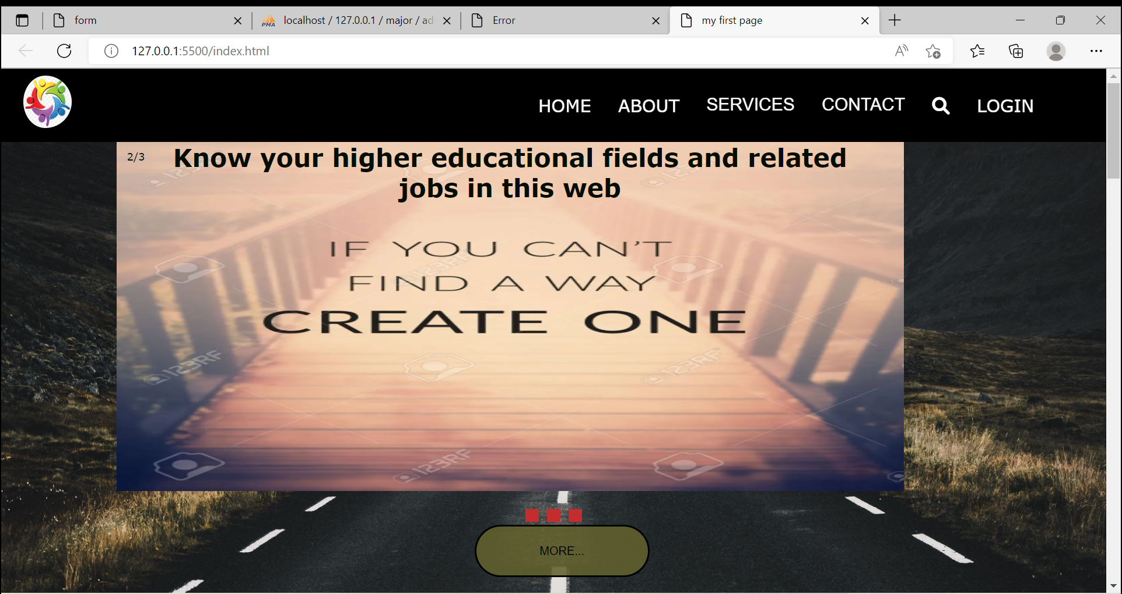
How its working?
The pages start with the home page where all pages are also include like about us ,services , contact us, and at the end footer section .

Slide 8
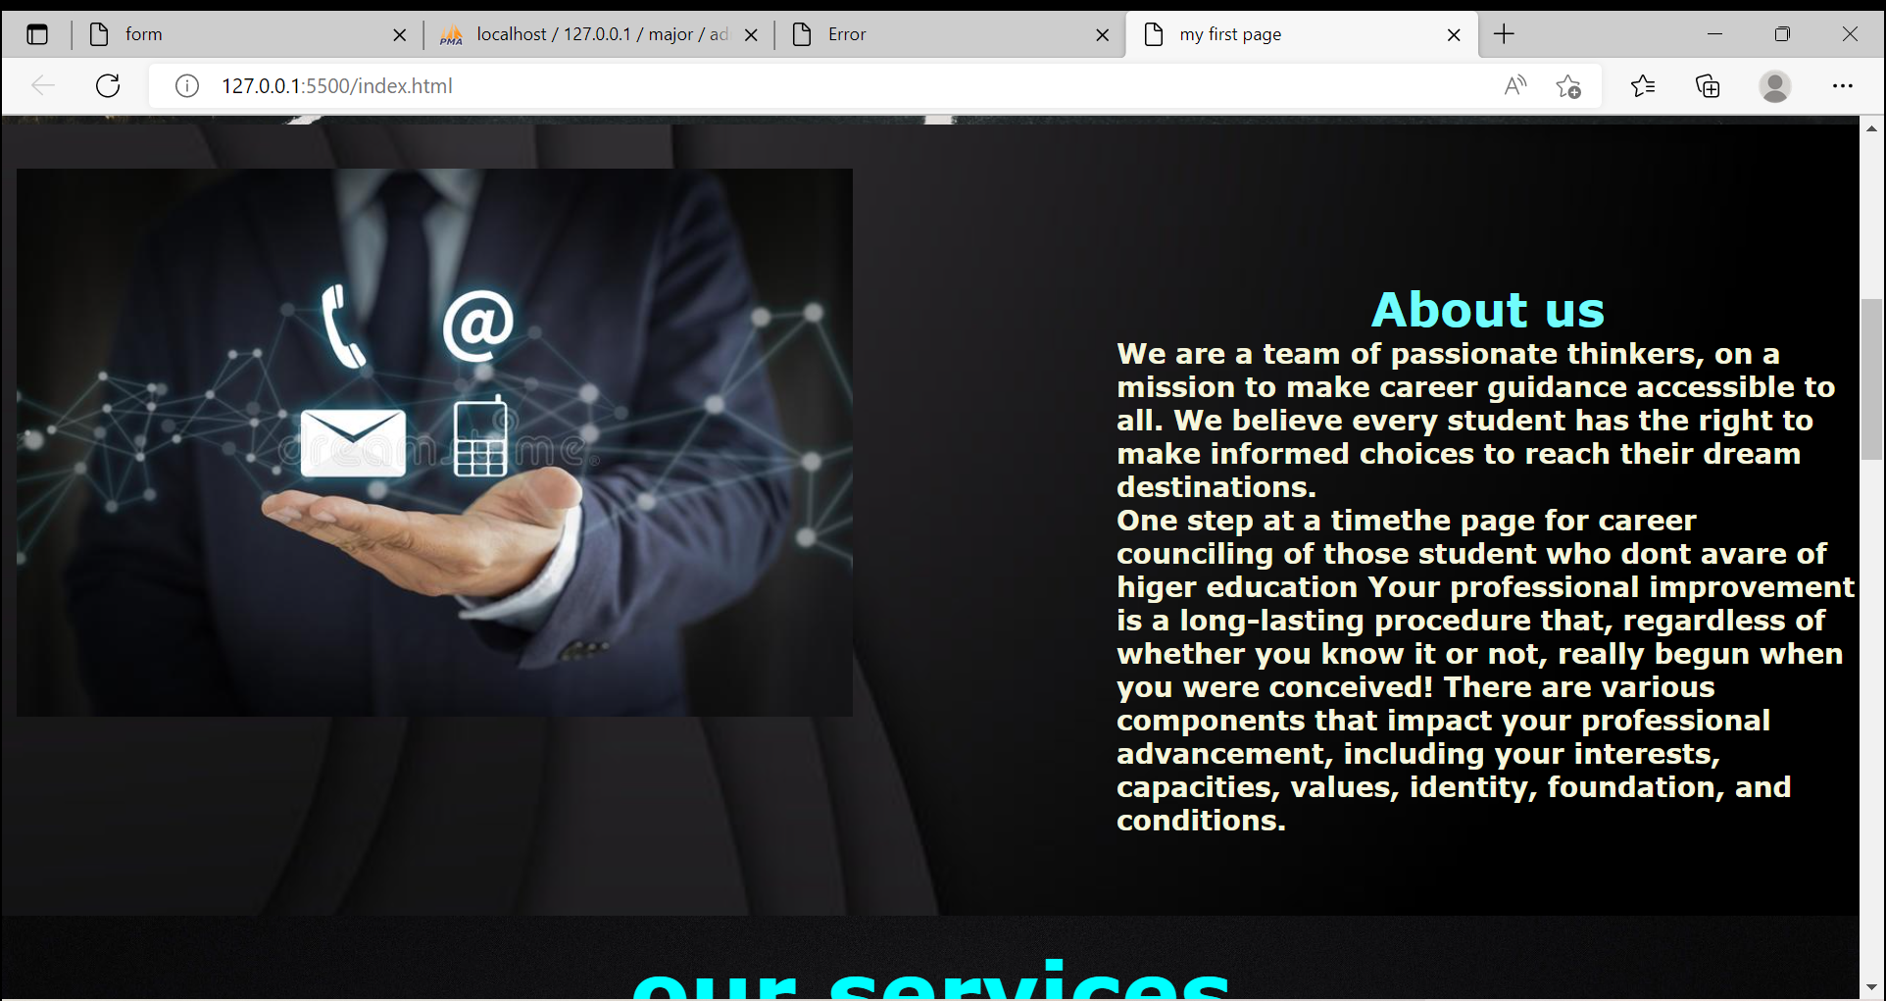
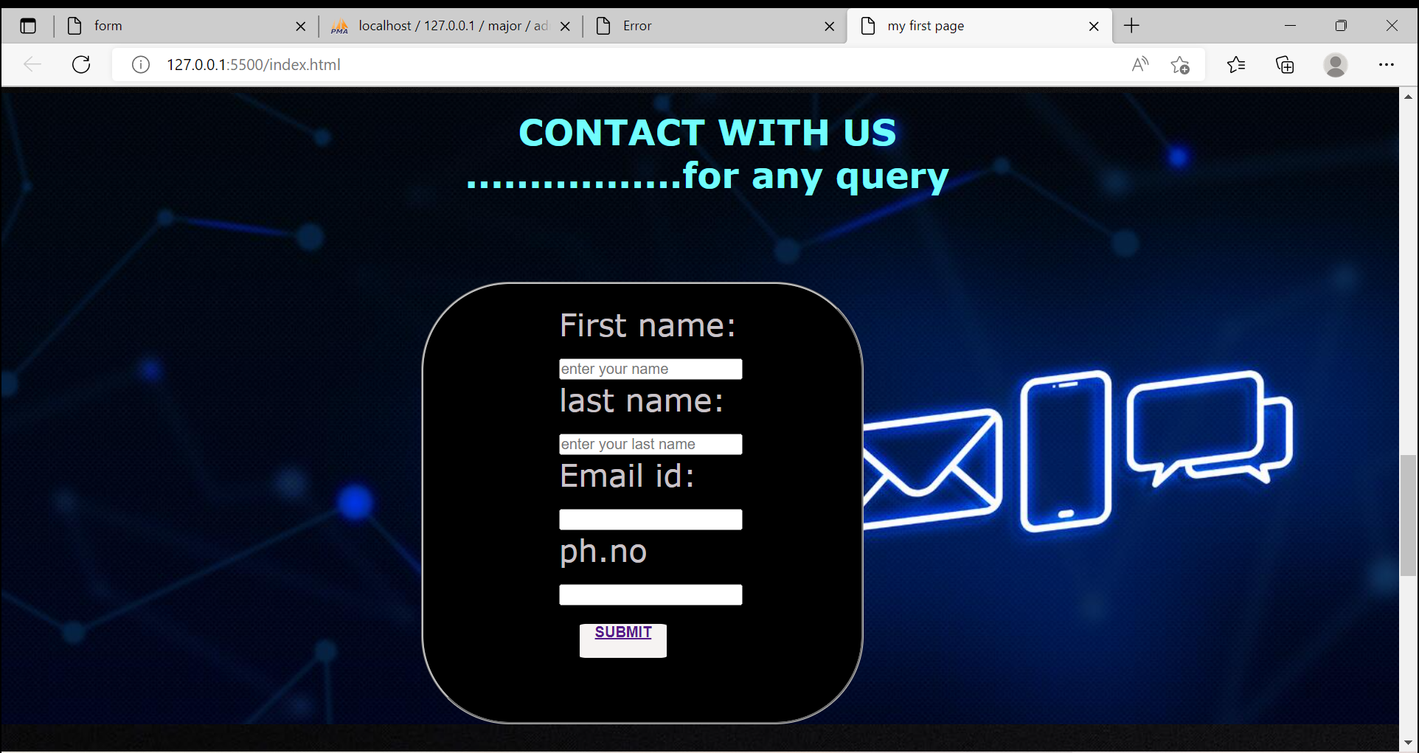
About section and contact section

Slide 9
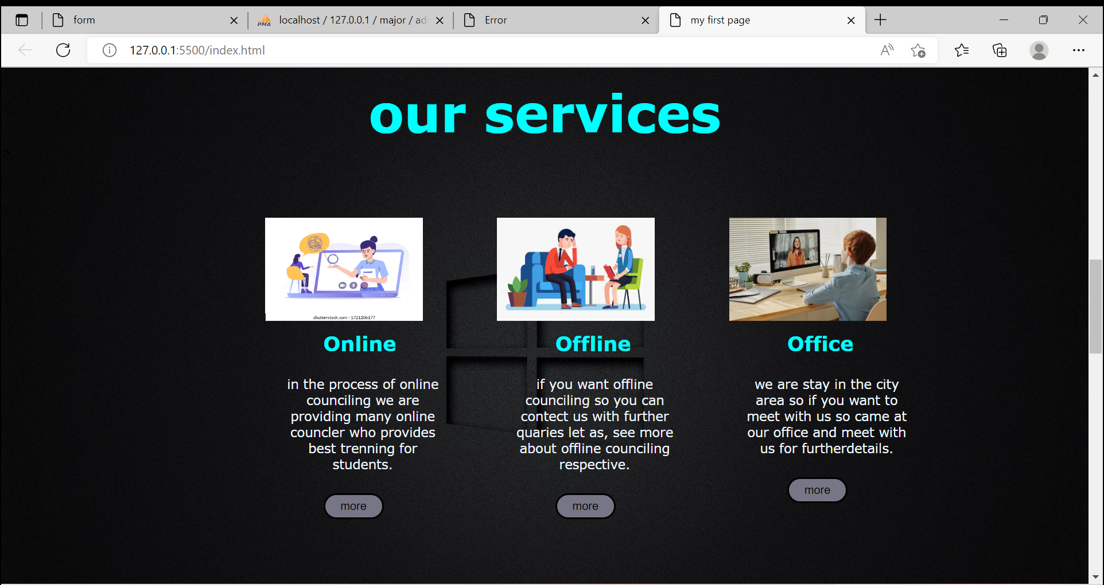
services in different modes

Slide 10
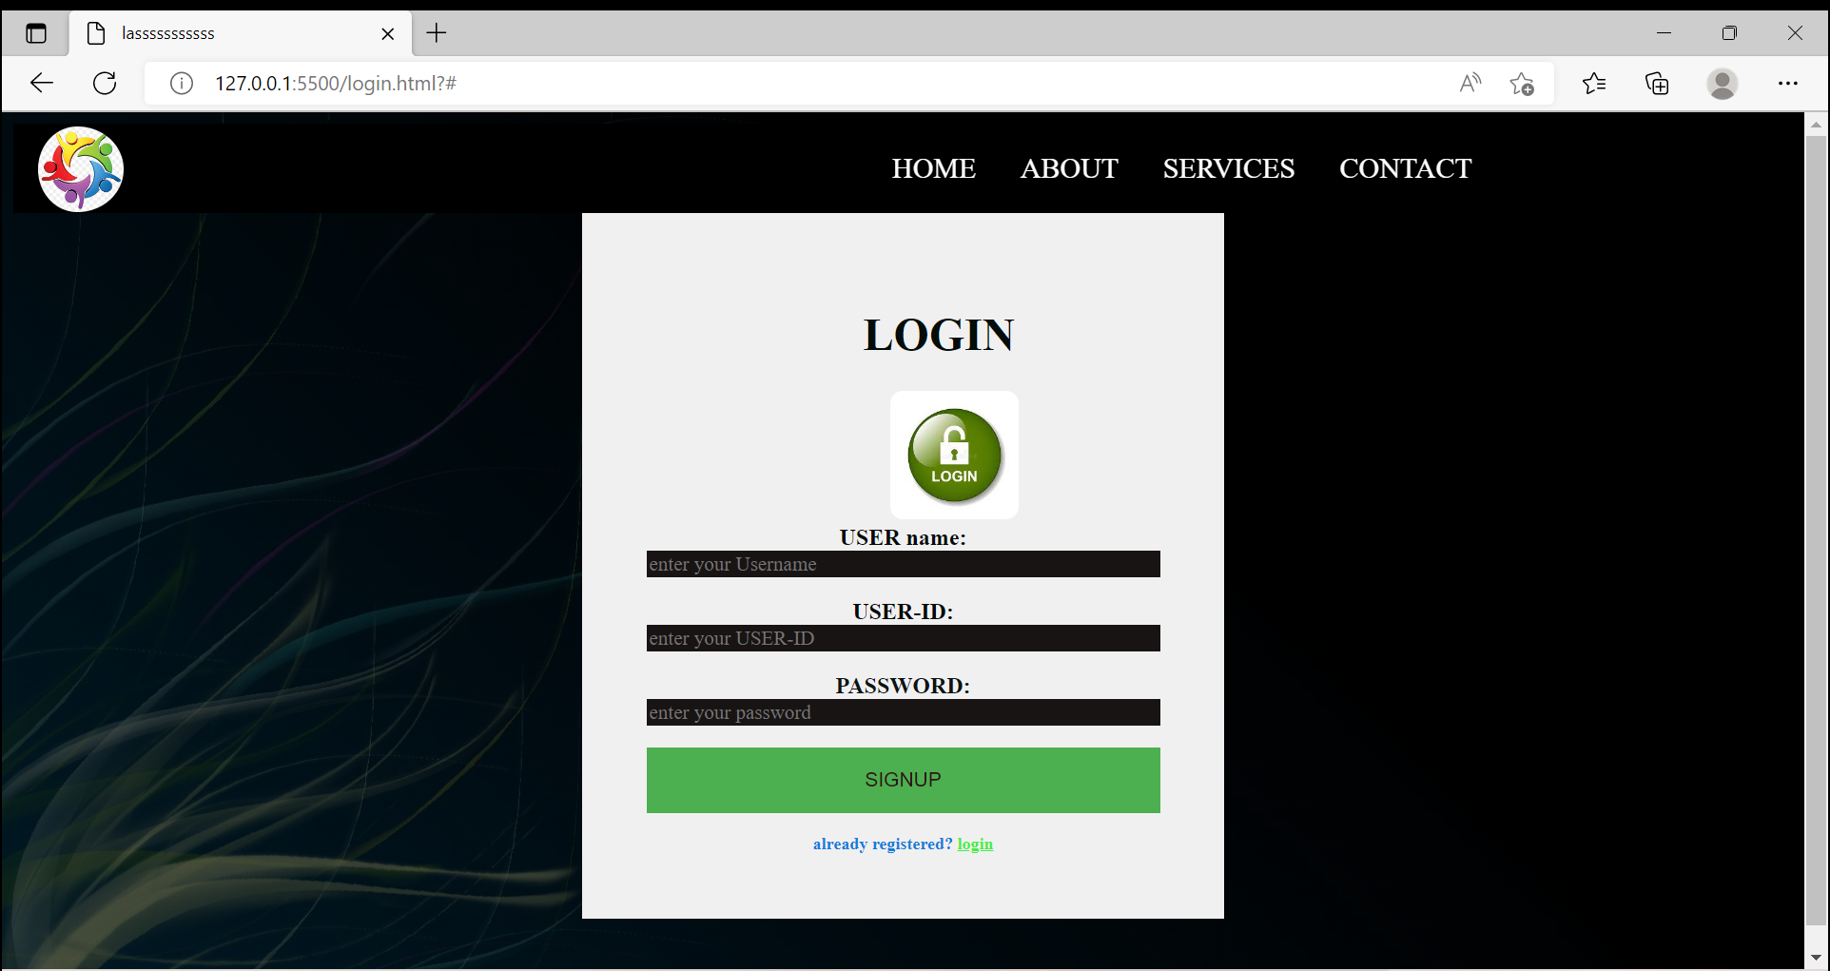
Login or signup section

Slide 11
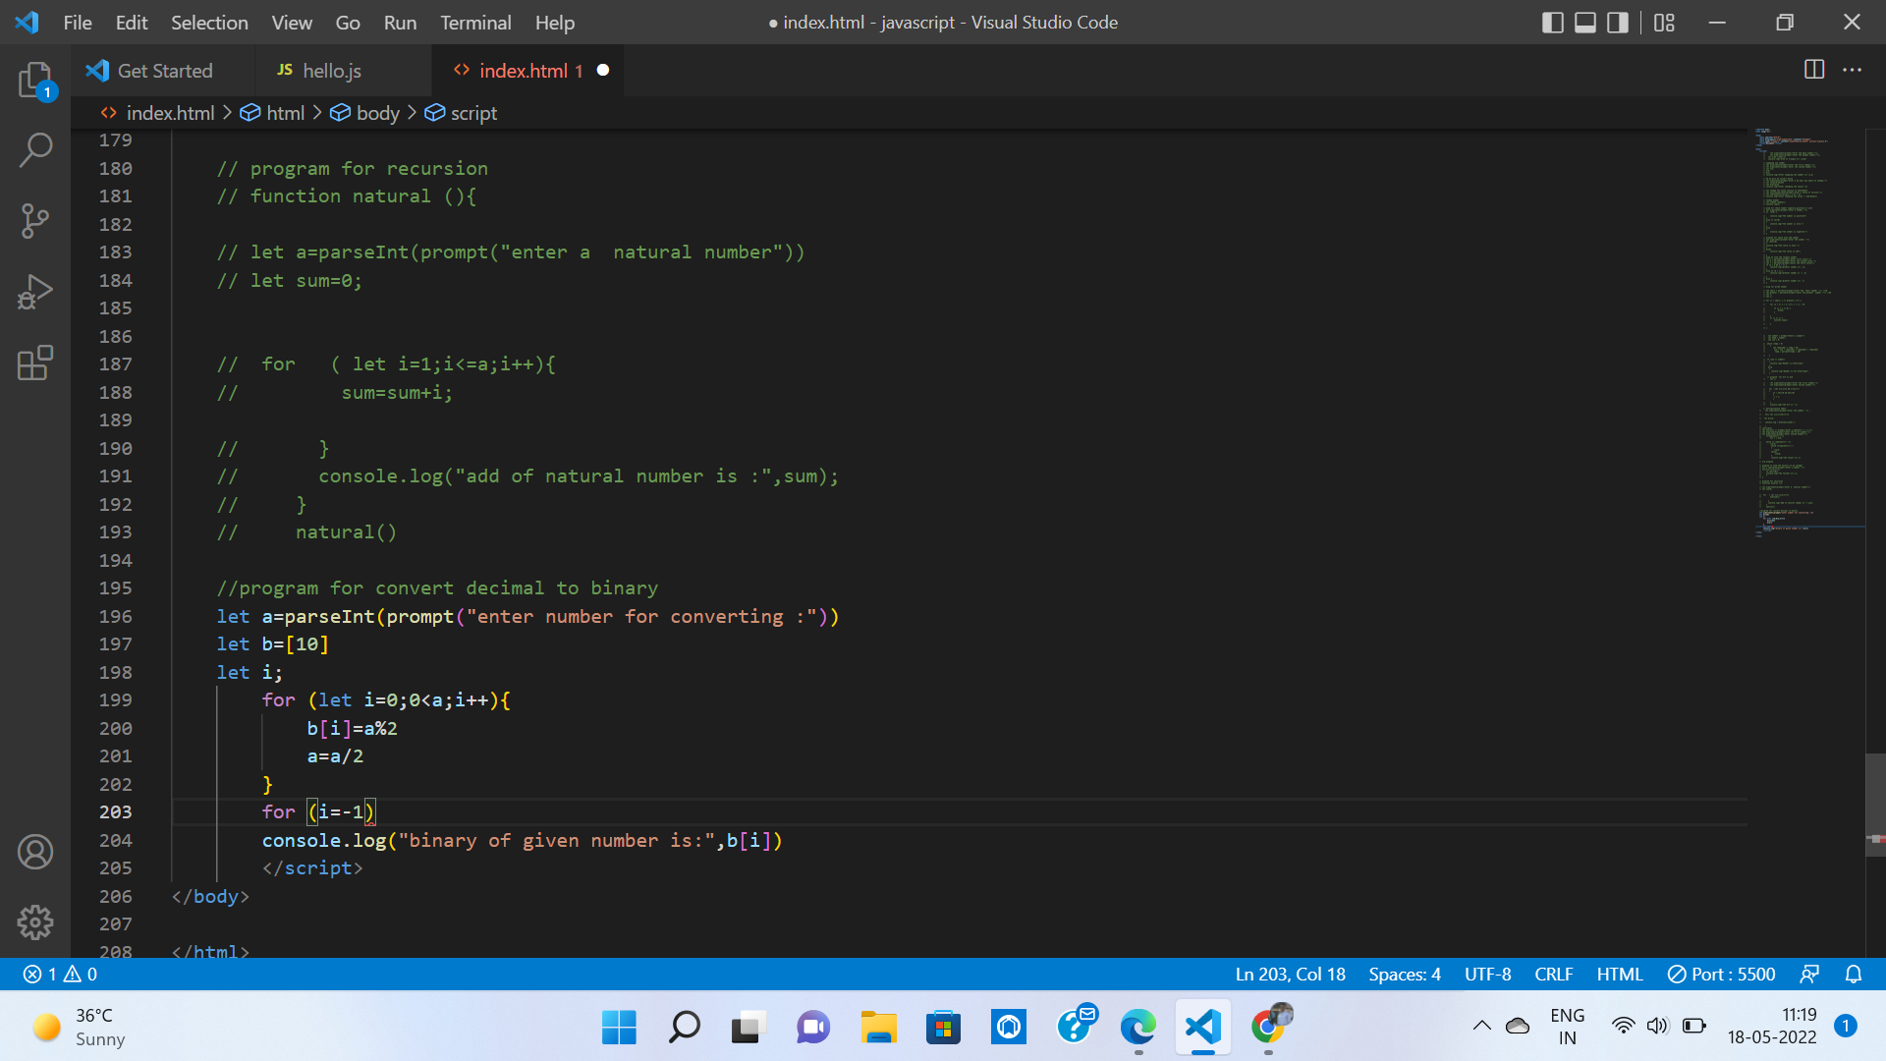
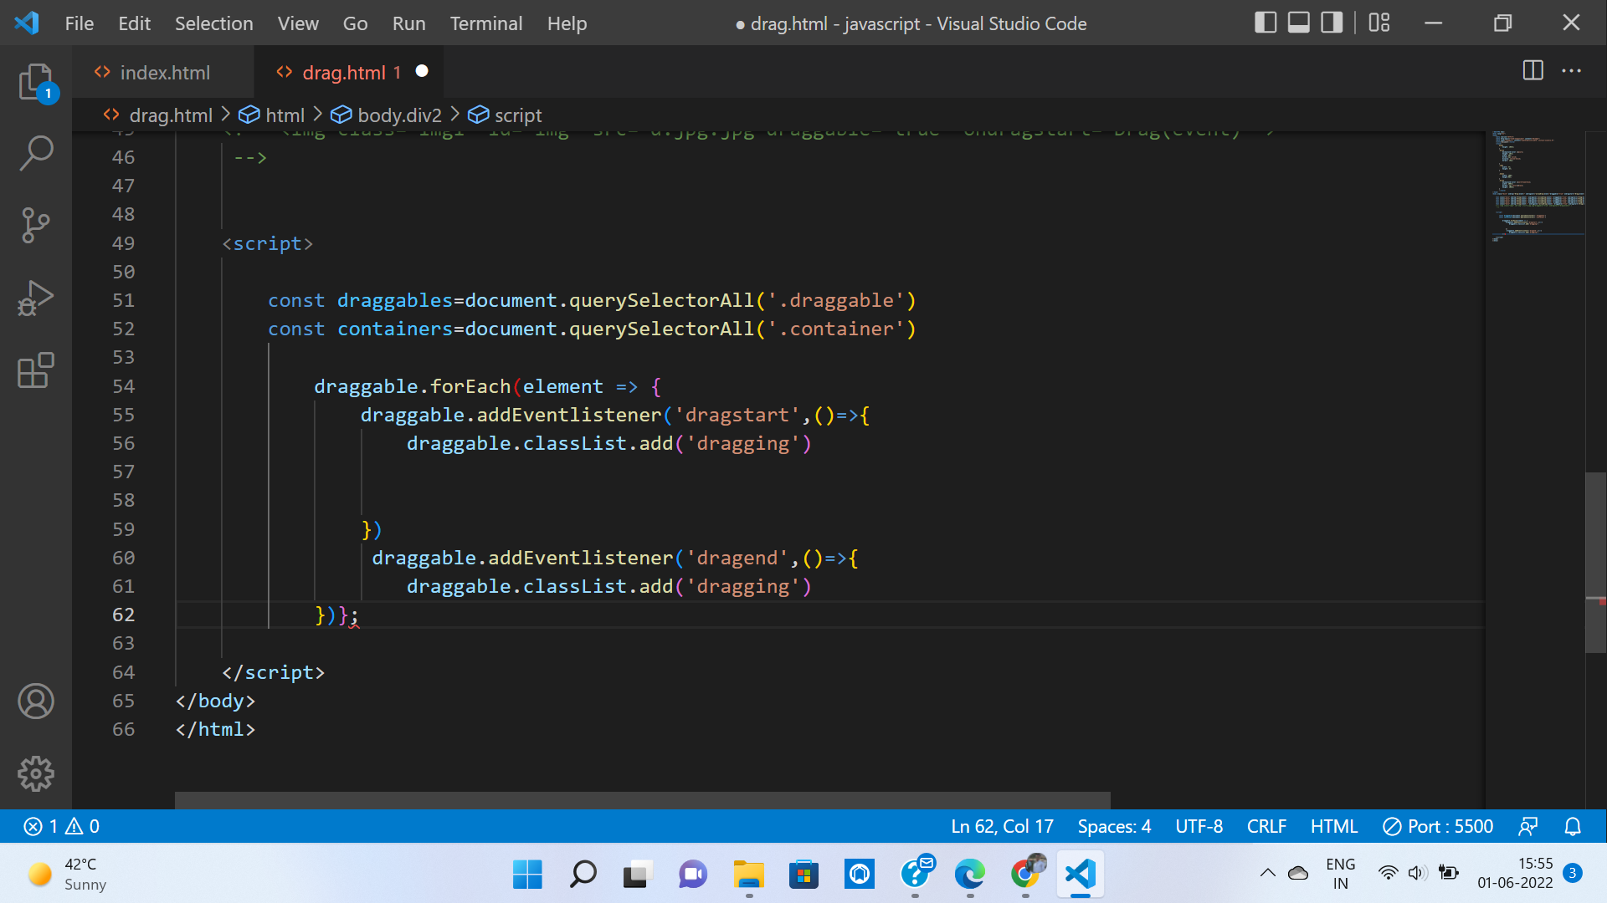
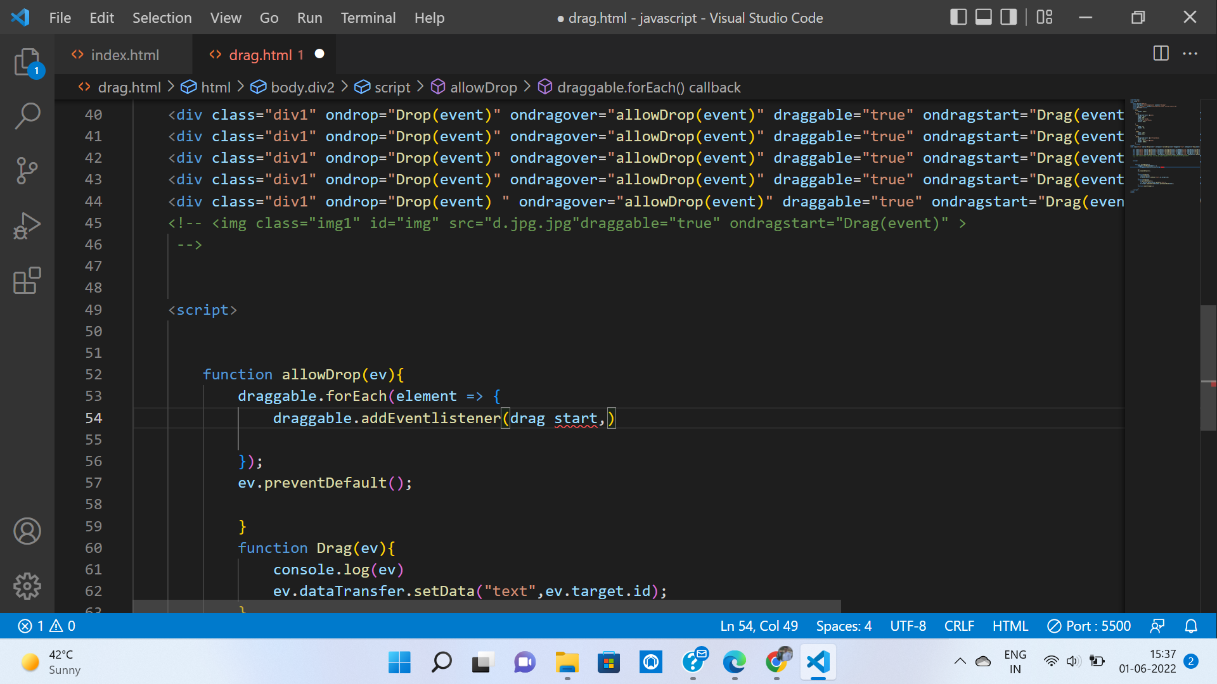
Coding section

Slide 12
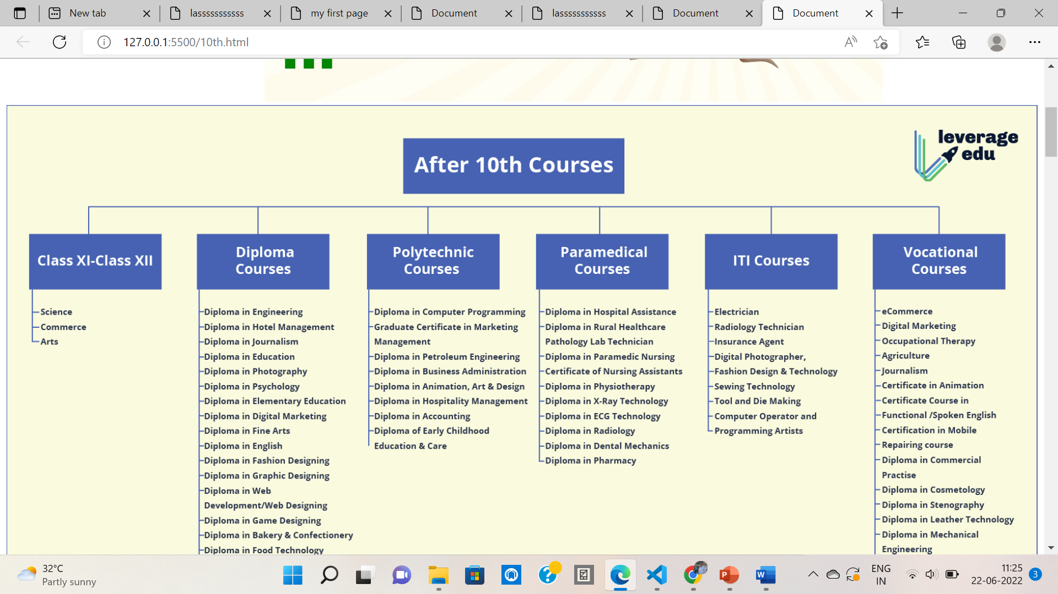
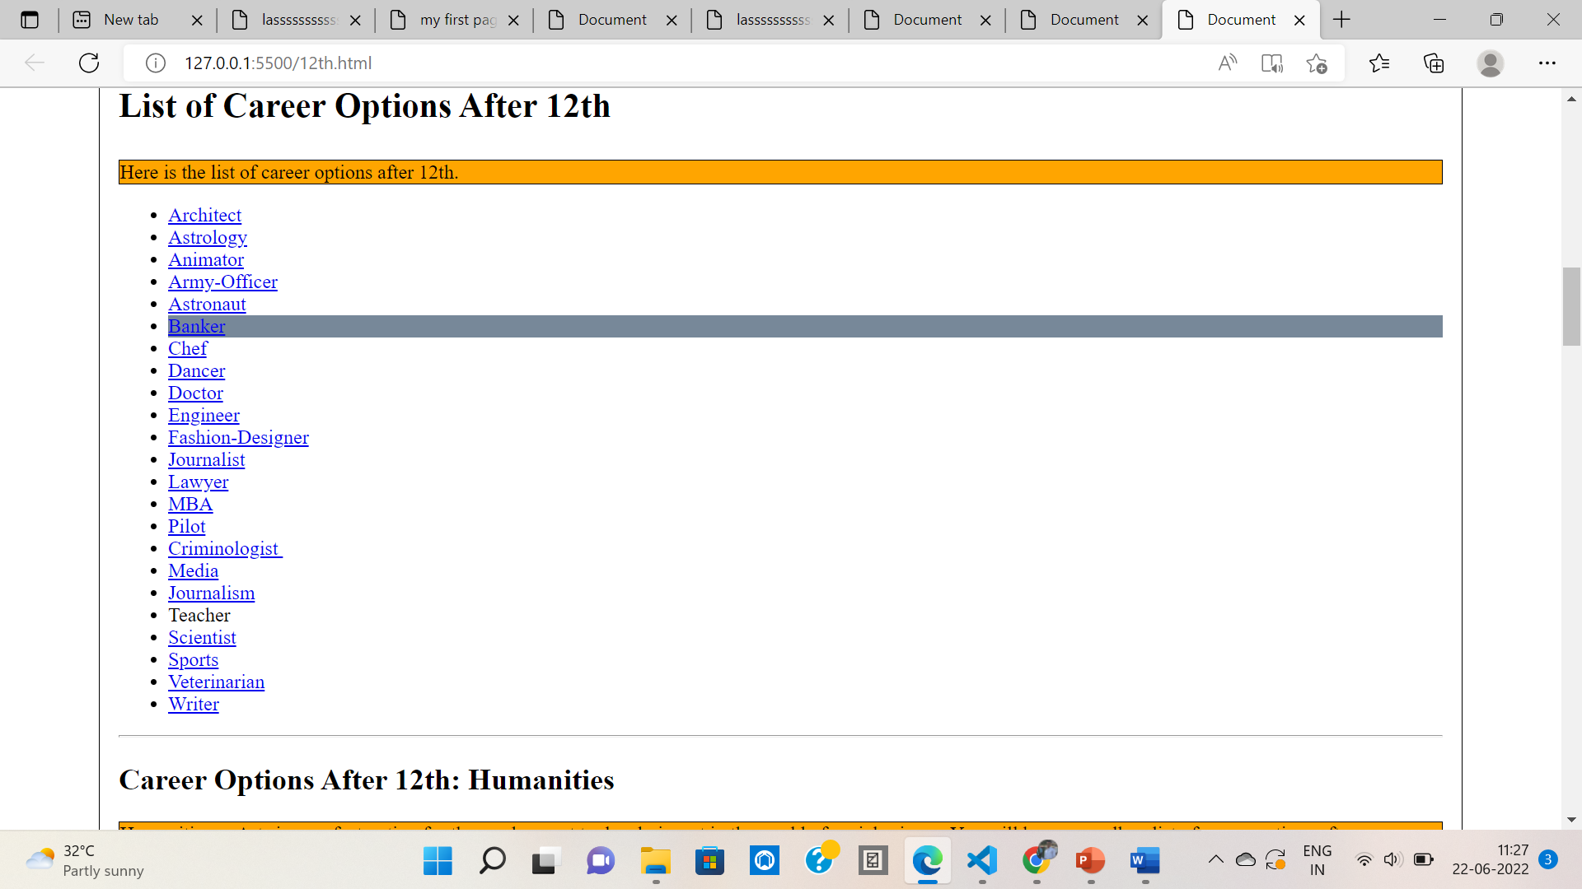
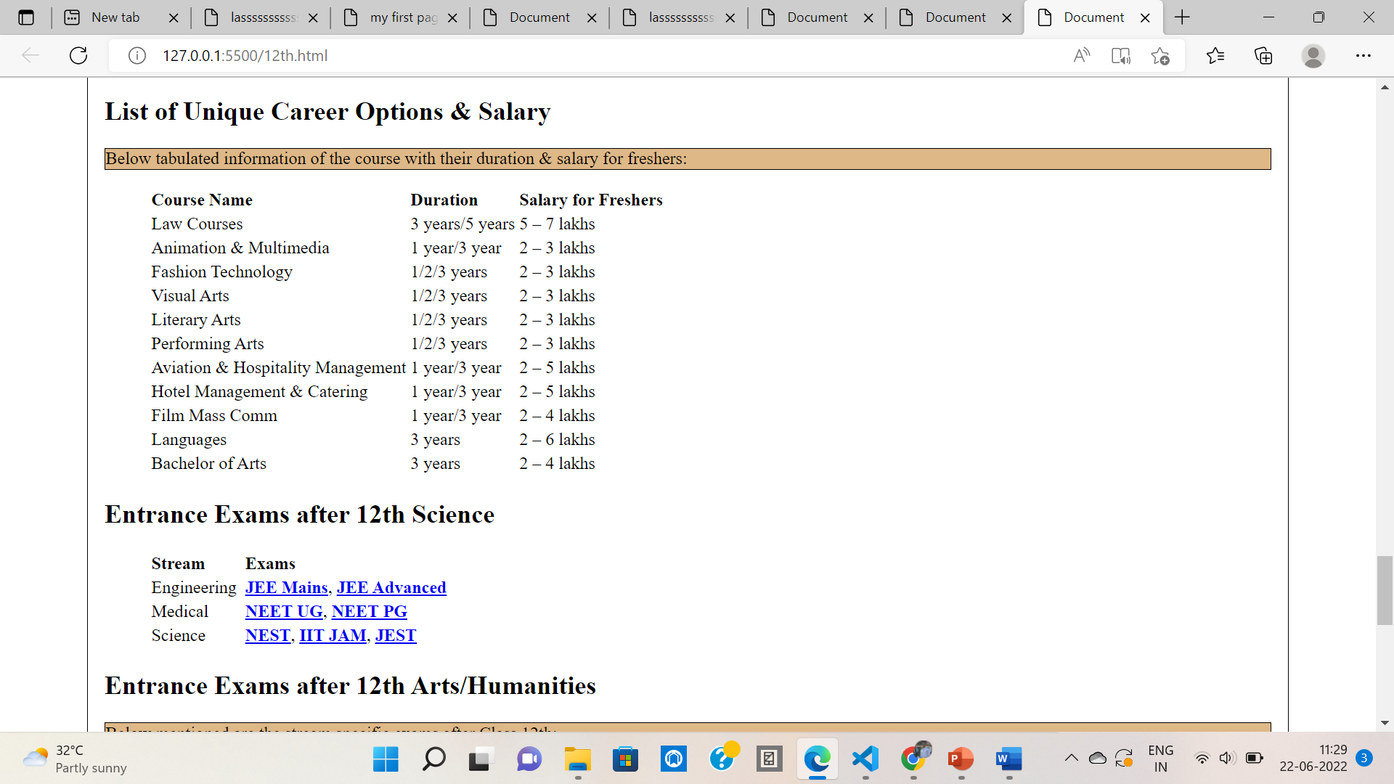
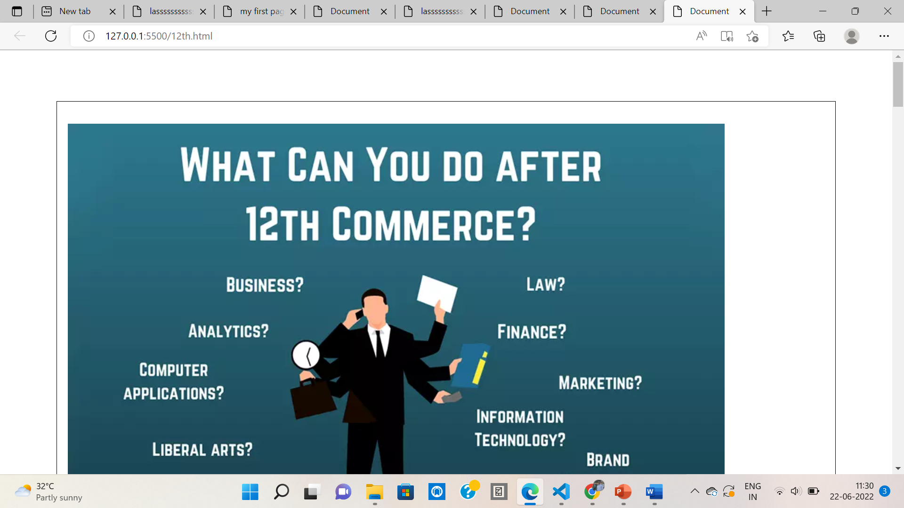
Result portion

Slide 13
references
REFERENCES
Atch. T., & Bowers. J (2005). The ASCA National Mode: Afome Work For School Counseling Programs.
Bukoye, R.O. (2006). Career Guidance For Basic And Secondary School Education (2nd ED.).
Cascading Style Sheets. In Wikipedia (January,2014) Retrieved From Http://En.Wikipedia.Org/Wiki/CSS_Style_Sheets.
Dawn, R. M. (2012). “What Is Career Guidance” Retrieved
From Http://Careerplanning.About.Com/Od/Careerchoicechan /F/Career-Guidance.Htm.
Design. In Wikipedia(January,2014) Retrieved From Http://En.Wikipedia.Org/Wiki/Design.

Slide 14
Thank you

